Slide 1
Cosmos DB Architecture and partitioning
Luciano Moreira
FastTrack for Azure

Slide 2
Agenda Cosmos DB architecture SDK interaction with Cosmos DB Partition design and scalability Q&A

Slide 3
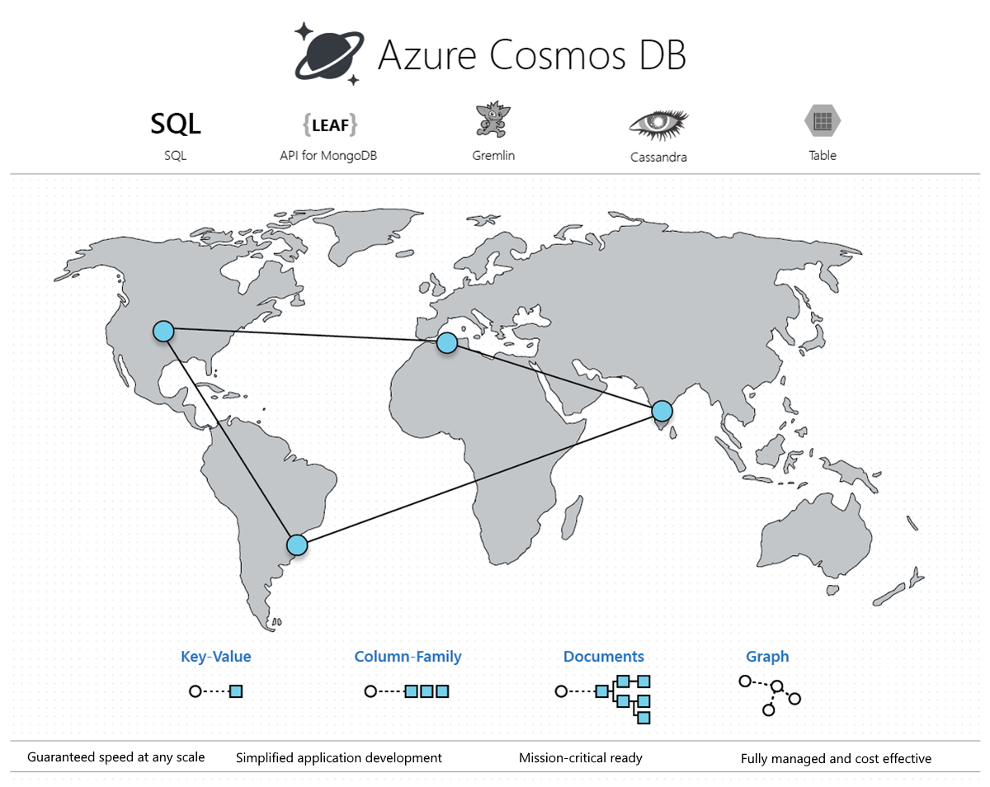
Azure Cosmos DB is a fully managed NoSQL database service for modern app development. Get guaranteed single-digit millisecond response times and 99.999-percent availability, backed by SLAs, automatic and instant scalability, and open-source APIs for MongoDB and Cassandra.

Slide 4
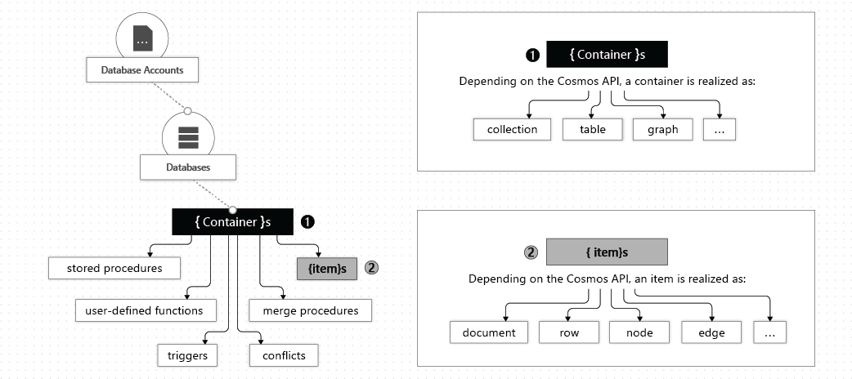
Resource model

Slide 5
Overview
Cosmos DB Gateway
Cosmos DB Backend
Client App
P1
P4
P2
P5
P3
P6
Azure

Slide 6
SDK

Slide 7
SDK + Service interaction
Master
Client App
Cosmos DB Gateway
Metadata operations
New CosmosClient()
… GlobalEndpointManager
… PartititionMap
https://github.com/Azure/azure-cosmos-dotnet-v3/tree/master/Microsoft.Azure.Cosmos/src/Routing
ReadItemAsync()
Cross Partition Query
Insert Item
P1
5 RUs
P
S
10 RUs
S
F
1 RU
P2
P3
1 RU
8 RUs
P4
24 RUs
5 RUs
3 RUs
Azure
3 RUs
Notes:
https://github.com/Azure/azure-cosmos-dotnet-v3/tree/master/Microsoft.Azure.Cosmos/src/Routing

Slide 8
SDK + Service interaction
Master
Client App
Cosmos DB Gateway
Metadata operations
New CosmosClient()
(Direct Mode - .NET/Java)
ReadItemAsync()
P1
P
S
S
F
P2
URI: rntbd://cdb-ms-prod-westus1-fd46.documents.azure.com:14086/apps/82691bd9-bcdd-44c4-b8e3-0722d357b80d/services/ac1ae6f9-04d6-45b9-8862-f4c80ef7463b/partitions/4e5c5f30-8909-405b-91e4-5202d80e2eca/replicas/132487105498618604s/
Connection: 10.0.0.15:50393 -> 40.112.241.46:14086
P3
P4
Azure

Slide 9
SDK + Service interaction
Master
Client App
Cosmos DB Gateway
Metadata operations
New CosmosClient()
(Direct Mode - .NET/Java)
Request Units (RUs)
P1
Multiple
Operations
Status code 429 (Throttling)
https://docs.microsoft.com/en-us/rest/api/cosmos-db/http-status-codes-for-cosmosdb
Azure
Budget
Budget

Slide 10
Partitioning

Slide 11
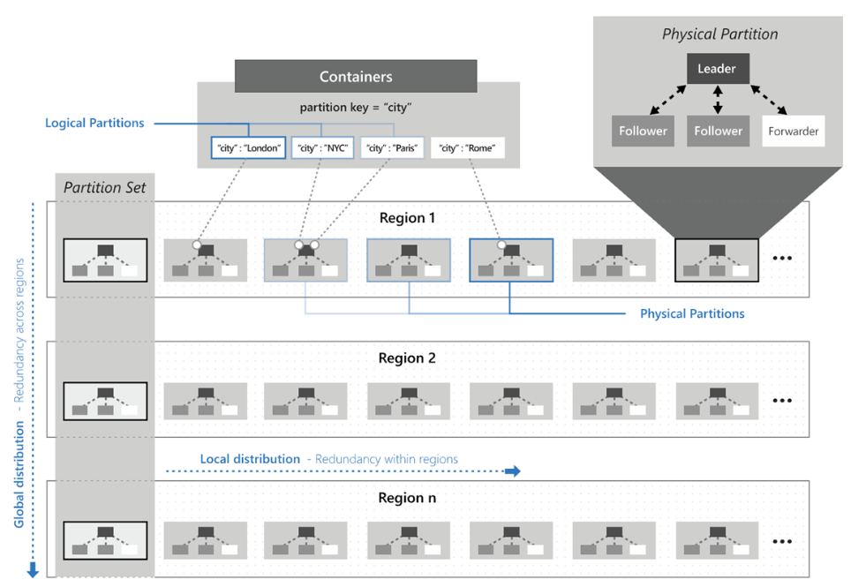

Slide 12
Partition design
{ id = GUID1, City = “Seattle”, P1 = “X” }
{ id = GUID2, City = “Seattle”, P1 = “Z” }
{ id = GUID3, City = “Seattle”, P1 = “A” }
{ id = GUID4, City = “Seattle”, P1 = “B” }
Partition 1
1
Logical p 1
20 GB = Max logical partition size
Consistent hashing
algorithm
Logical p 2
F(partkey) = hash
100
MAX: 10 K RUs per physical partition
MAX: 50 GB
101
Partition 2
Logical 101
Logical 102
F(“Seattle”) = 101
Collection with 15000 RUs => at least 2 physical partitions.
7500 RUs foreach partition
F(“New York”) = 1
F(“Dallas”) = 102
F(“Orlando”) = 2
200
Notes:
https://en.wikipedia.org/wiki/Consistent_hashing

Slide 13
Partition design
20 GB = Max logical partition size
MAX: 10 K RUs per physical partition
MAX: 50 GB
Partition 1
1
Logical p 1
Logical p 2
Logical 22
F(partkey) = hash
100
101
Partition 2
Logical 101
Logical 102
Logical 199
Partition 2 is getting full => Partition split
200
Logical 200

Slide 14
Partition design
20 GB = Max logical partition size
MAX: 10 K RUs per physical partition
MAX: 50 GB
Partition 1
1
Logical p 1
Partition 3
Logical 101
Logical p 2
Logical 22
Logical 150
F(partkey) = hash
100
101
Partition 2
Logical 101
Partition 4
Logical 151
Logical 102
Logical 199
Logical 200
200
Logical 200

Slide 15
Partition design
20 GB = Max logical partition size
Partition 1
1
Logical p 1
MAX: 10 K RUs per physical partition
MAX: 50 GB
Logical p 2
101
Partition 3
Logical 101
Logical 22
100
5000 RUs
Logical 150
F(partkey) = hash
150
5000 RUs
151
Partition 4
Logical 151
Logical 200
200
5000 RUs

Slide 16
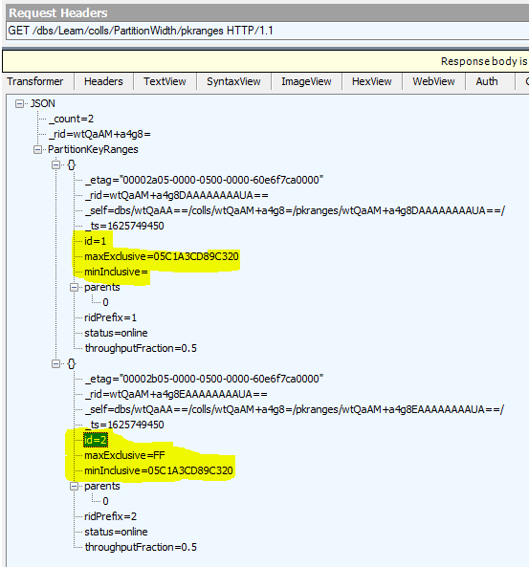
Partition key range

Slide 17
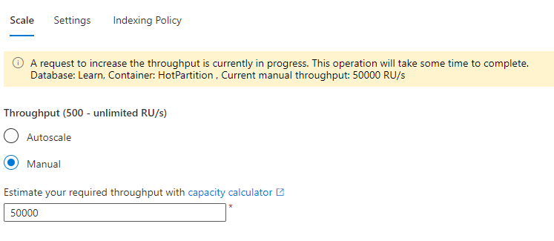
Portal warning – throughput increase

Slide 18
Hot partition

Slide 19
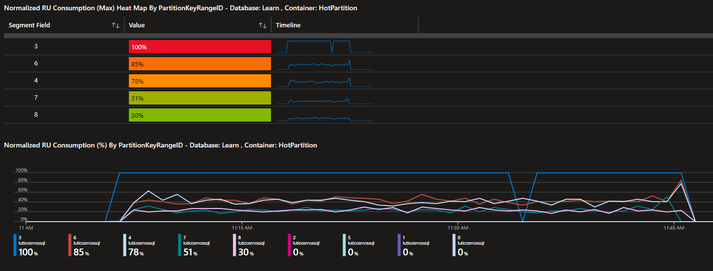
Monitoring Insights

Slide 20
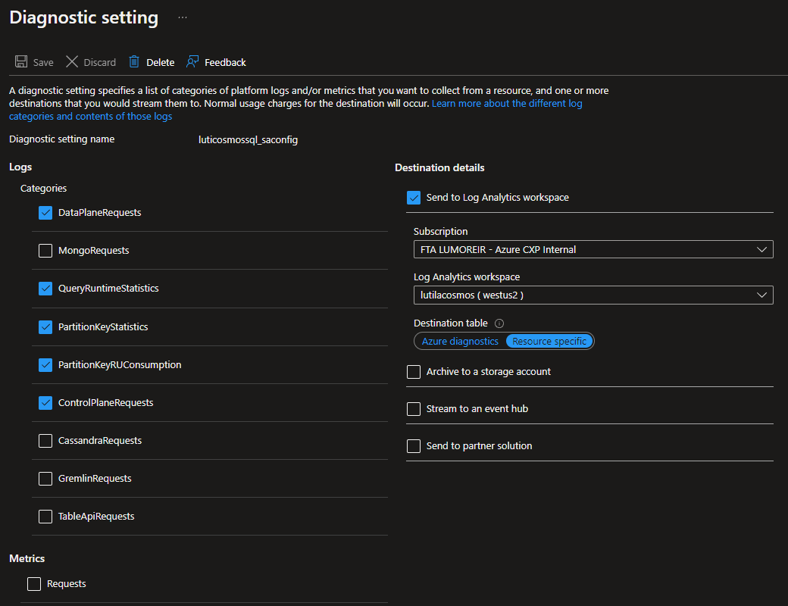
Log Analytics
Notes:
CDBPartitionKeyRUConsumption
| where CollectionName == "HotPartition"
| where TimeGenerated >= todatetime("2022-05-17 11:00")
| where TimeGenerated <= todatetime("2022-05-17 12:00")
| where OperationName == "Create"
| where PartitionKeyRangeId != ""
| take 100;
CDBPartitionKeyRUConsumption
| where TimeGenerated >= todatetime("2022-05-17 11:00")
| where TimeGenerated <= todatetime("2022-05-17 12:00")
| where CollectionName == "HotPartition"
| where PartitionKeyRangeId != ""
| summarize TotalRUs=sum(RequestCharge) by PartitionKeyRangeId
| order by TotalRUs desc
CDBPartitionKeyRUConsumption
| where TimeGenerated >= todatetime("2022-05-17 11:00")
| where TimeGenerated <= todatetime("2022-05-17 12:00")
| where CollectionName == "HotPartition"
| where PartitionKeyRangeId == 2
| summarize sum(RequestCharge) by PartitionKey
| sort by sum_RequestCharge desc
| take 10;
Monitor Azure Cosmos DB data by using Azure Diagnostic settings | Microsoft Docs
Azure Monitor Logs reference - CDBPartitionKeyStatistics | Microsoft Docs

Slide 21
Partition design
Partition key based on timestamp: YYYYMMDDHH
Ex.: Bluetooth devices
Betting system using a game as partition key (“Barcelona_RealMadrid_20210101”)
TinyURL
Global unique identifier (GUID)

Slide 22
Conclusion
Understand Cosmos DB architecture and partition design
Application instrumentation is crucial for troubleshooting
RU budget and throttling are your friend
When used efficiently, scalability and black Friday will not be a problem ☺

Slide 23
What is next? Tell us what you think at aka.ms/ftalive-feedback Help us improve this delivery format and let us know if this has been useful. Visit aka.ms/ftalive to sign up for other topics - they are open to everyone.

Slide 24
Questions? luciano.moreira@microsoft.com

Slide 25
Appendix

Slide 26
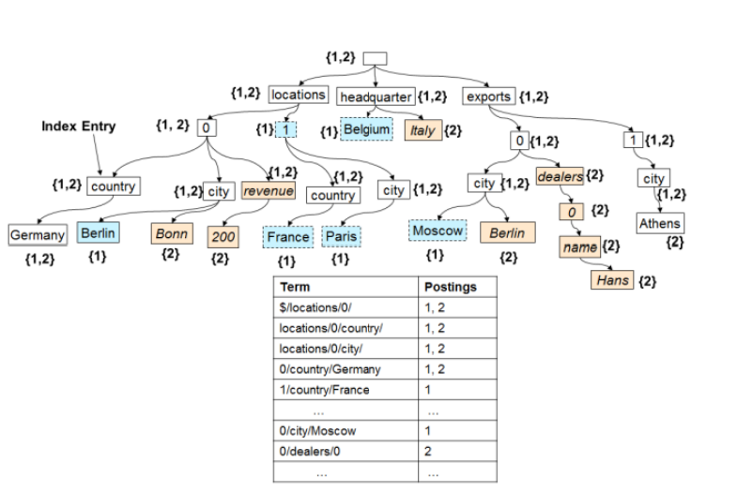
Inverted index
https://www.vldb.org/pvldb/vol8/p1668-shukla.pdf
Schema-Agnostic Indexing with Azure DocumentDB

Slide 27
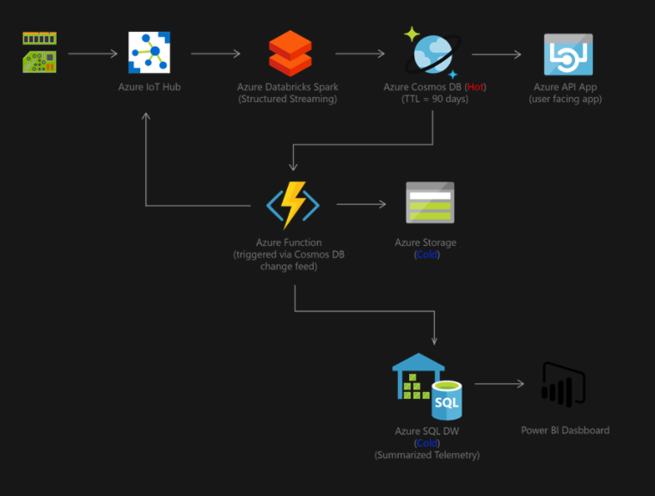
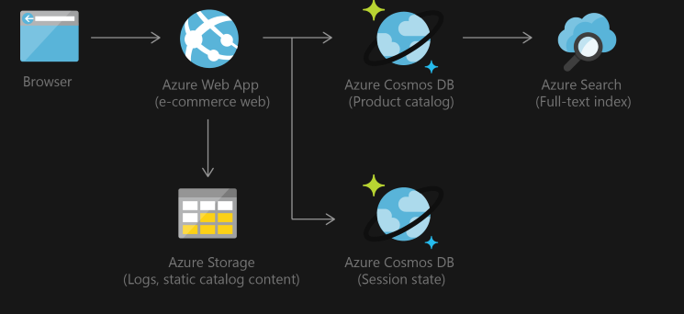
Scenarios
https://docs.microsoft.com/en-us/azure/cosmos-db/use-cases
https://gotcosmos.com/architecture

